Slide 1
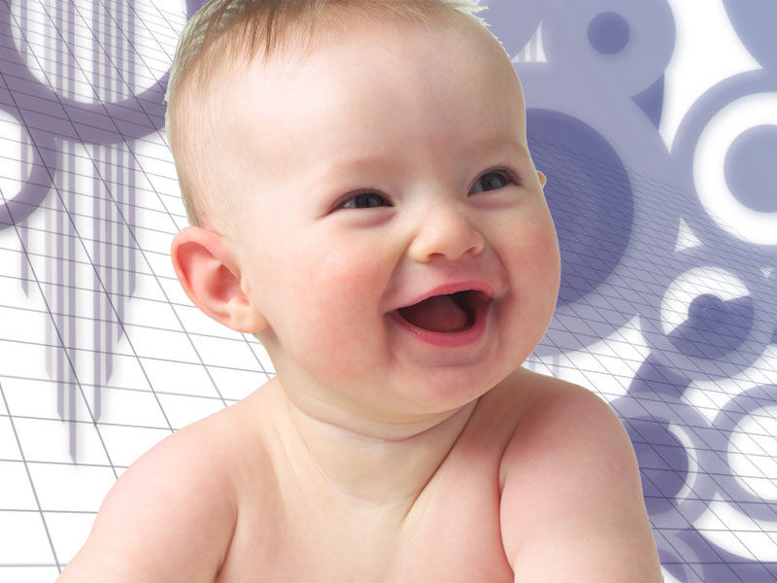

GOOD MORNING
SAY TO GOOD MORNING

Slide 2
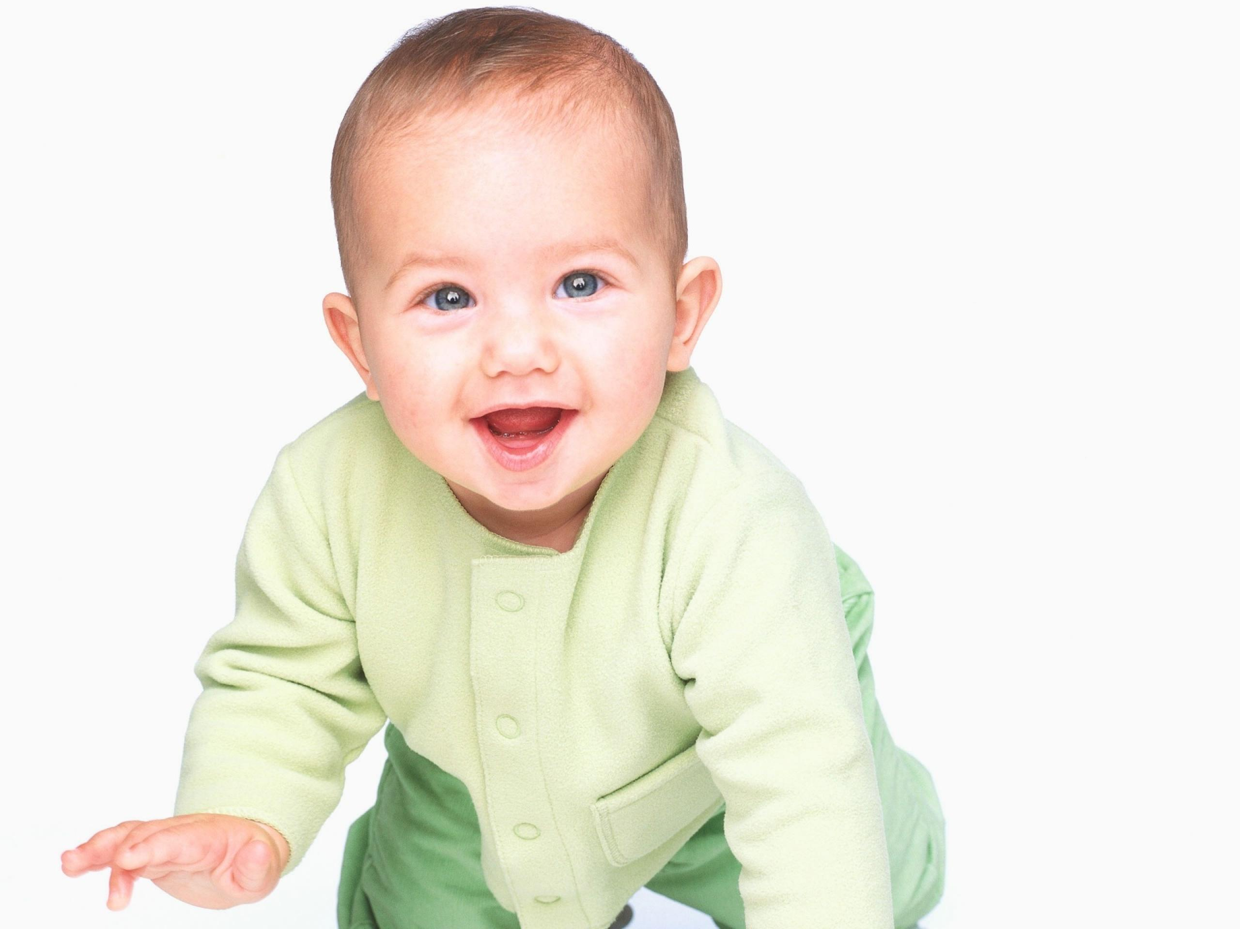
Let’s laugh

Slide 3
